Slide 1
5 days of counting
Lisa Harper 1/6/20

Slide 2
Things to remember when counting:
One to one correspondence is the key to children learning. This means that they know that 5 is 5 things and they securely count them using one number for each object.
Encourage your child to count everything and anything.

Slide 3
Activity 1
This weeks rhyme is Zoom, Zoom, Zoom.
Zoom, zoom, zoom we’re going to the moon
Zoom, zoom, zoom we’ll be there very soon
In 5 4 3 2 1 Blast off

Slide 4
Activity 2 –Underpants number line
Can you make a number line out of pants. You could make the pants first and put the numbers 1-10 on them and then put them in the correct order. You could also make a washing line and peg them up in order.

Slide 5
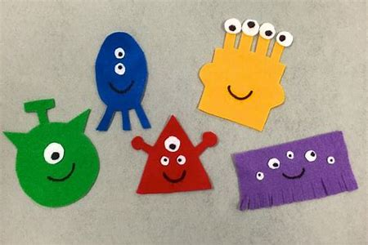
Activity 3 – Alien eyes
Start by making an alien with no eyes on it. You could link this in with the craft alien on the fun activities PowerPoint. Then make some separate eyes (up to 10). Say a number and see if your child can place the correct number of eyes on their alien.

Slide 6
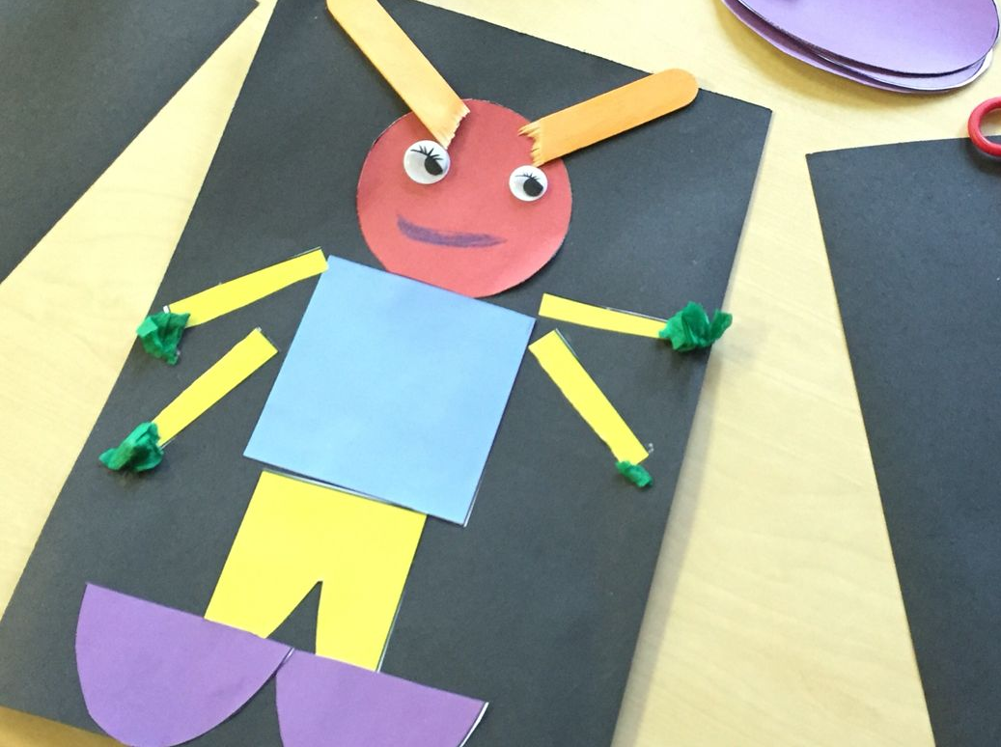
Activity 4 – Shape Aliens
Start by creating shapes out of paper. Make different size triangles, squares, rectangles, circles, hearts, diamonds and stars. Then get your child to explore making different aliens with the shapes.

Slide 7
Activity 5 – Count with Lecky
Go to www.crickweb.co.uk and have a go at the count with Lecky game.

