Slide 1
5 days of fun challenges For Reception and Pre-school
By Lisa Harper 1/6/20

Slide 2
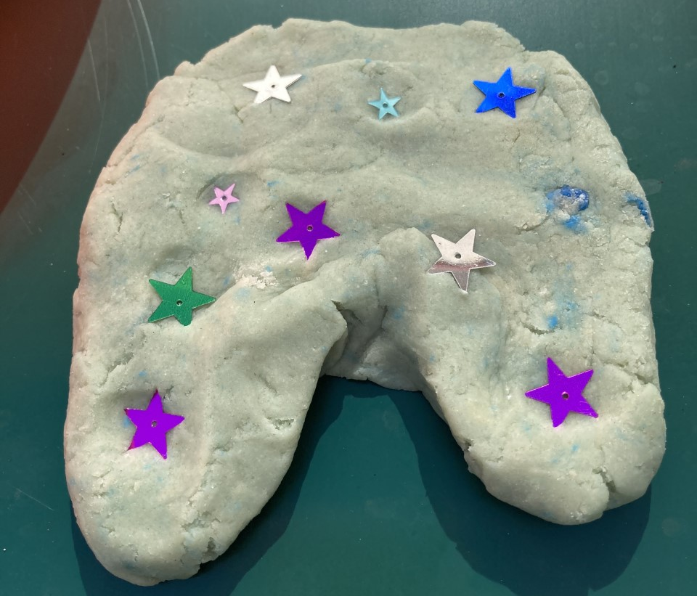
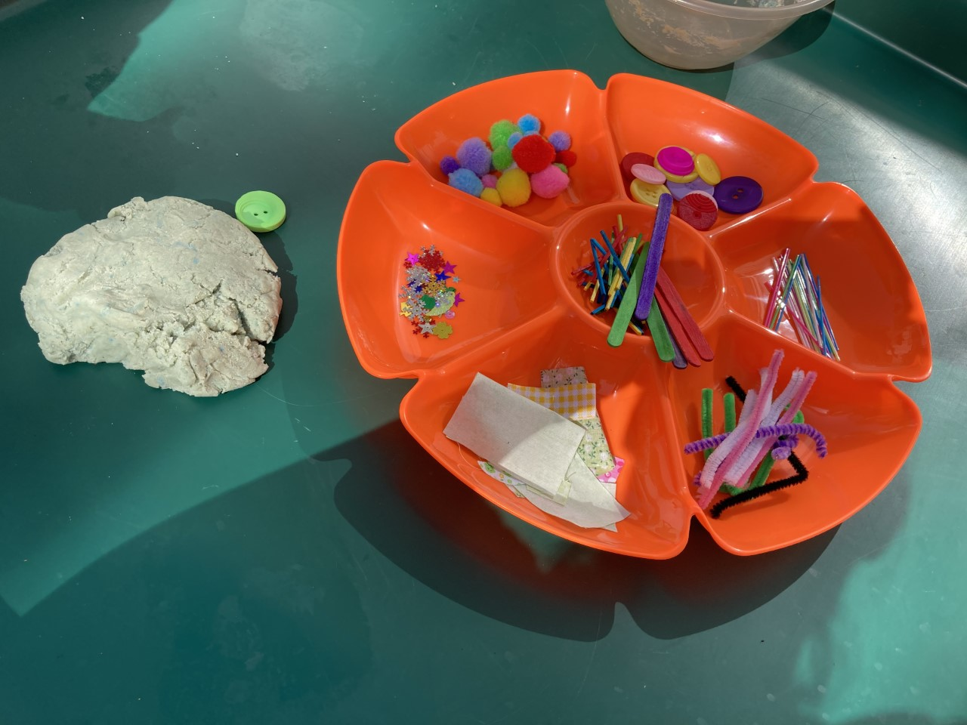
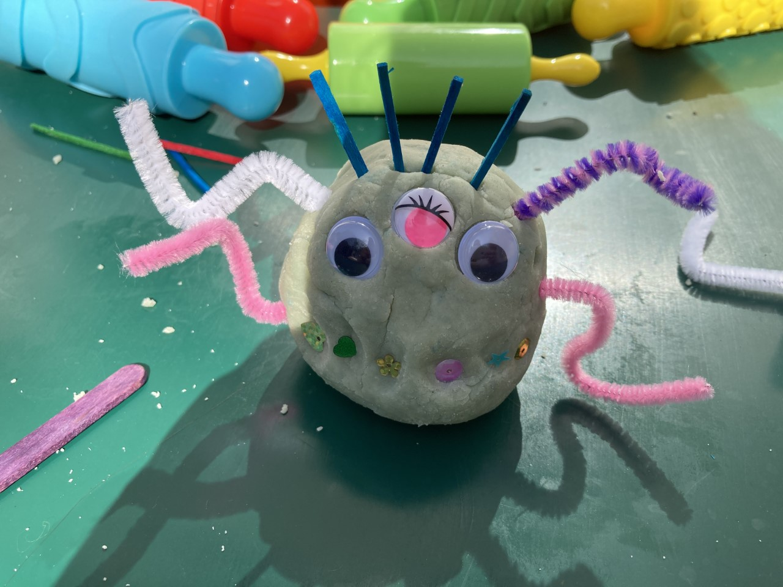
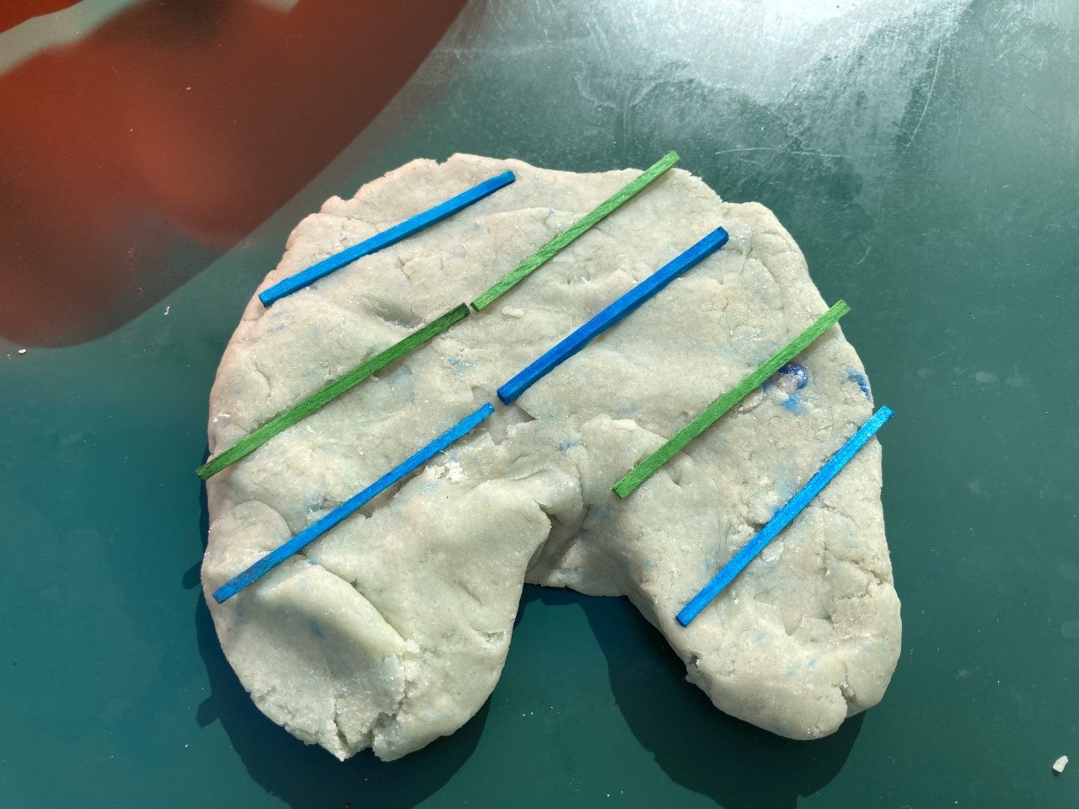
Activity 1- Playdough underpants and alien
What you will
Need:
Play dough
Buttons
Pompoms
Sequins
What the activity is:
Use play dough to make a pair of underpants and an alien. You could add buttons, sequins, pompoms etc to give details or you can just use different tools to create the details. I have attached a simple playdough recipe on the next slide.
Questions you can ask them:
What would you like to add to your pants?
How many eyes does your alien have?
What pattern are you going to add to your pants?

Slide 4
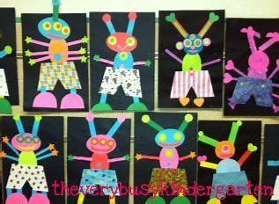
Activity 2-Craft underpants and alien
What you will
Need:
Craft resources of your choice
What the activity is:
Create an alien and a pair of underpants using whatever materials you would like. You can collage, paint, junk model, draw etc. Can you plan how you are going to make them before you start? (this can be done through talking.)
Questions you can ask them:
How are you going to make your alien?
What things do you need?
What colour is your alien going to be?

Slide 5
Activity 3- Stone alien
What you will
Need:
Stone/rock
Paint
Pens
Glue
Materials
What the activity is:
You will need a large stone/rock. Then paint your rock and add features using pens or gluing things onto it.
Questions you can ask them:
What colour are you going to paint your alien?
How many legs and arms is your alien going to have?

Slide 6
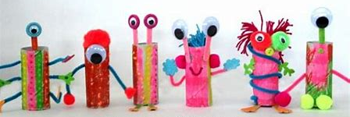
Activity 4- Toilet roll alien
What you will
Need:
Toilet tube
Scissors
Glue
Selection of materials
What the activity is:
Can you make an alien using a toilet roll tube? Can you find your own way to make an alien using the tube? Use any resources you have
Questions you can ask them:
How are you going to make your alien?
What materials do you need?
How many eyes is your alien going to have?

Slide 7
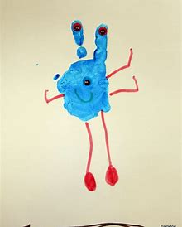
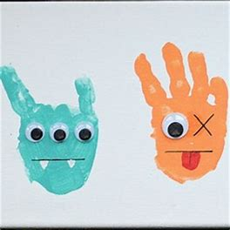
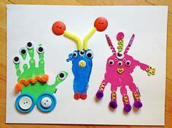
Activity 5- Handprint alien
What you will
Need:
Paint
Scissors
Glue
Materials
What the activity is:
Can you make an alien using your handprint? Start by choosing your colour and making the print. Then add features using materials of your choice.
Questions you can ask them:
What colour alien are you going to make?
What extra details can you add?

Slide 8
Activity 6- Lecky's friends and dress Lecky
What you will
Need:
iPad or laptop
What the activity is:
Go to www.crickweb.co.uk and have a go at playing some of the different interactive games with Lecky the alien.
Questions you can ask them:
What would Lecky need to wear if it cold?
What is your favourite colour t-shirt?

