Slide 1
5 days of maths
Lisa Harper 22/6/20

Slide 2
Things to remember when counting:
One to one correspondence is the key to children learning. This means that they know that 5 is 5 things and they securely count them using one number for each object.
Encourage your child to count everything and anything.

Slide 3
Activity 1 – 10 Little squirrels
This weeks song is 10 little squirrels. Sung to the tune of 10 little monkeys.
10 little squirrels jumping on the bed
One fell off and bumped his head
Mummy called the doctor and the doctor said
No more squirrels jumping on the bed
9 little squirrels jumping on the bed
One fell off and bumped his head
Mummy called the doctor and the doctor said
No more squirrels jumping on the bed

Slide 4
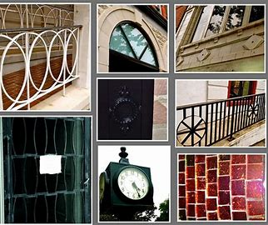
Activity 2 – Shapes in the environment
Go out for a walk and see what shapes you can see. Can you take some pictures of them?

Slide 5
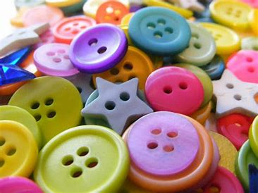
Activity 3 – Number matching
Write numbers 0-5 or beyond. Can you find the right amount of objects to match the number? Can you count out the right amount of objects to match the number from a large group of objects (eg buttons)?
5

Slide 6
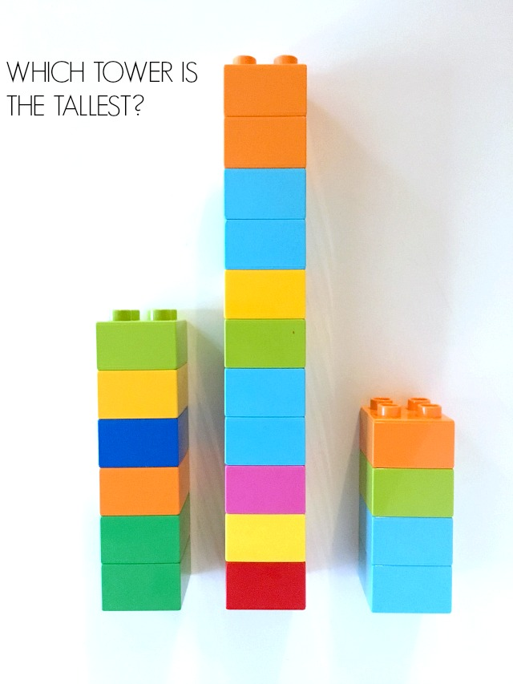
Activity 4 – Block towers
Can you make different size towers with blocks. Can you talk about which one is the shortest and which one is the tallest? How many blocks do they have?

Slide 7
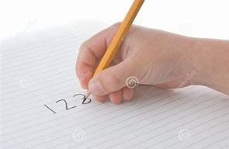
Activity 5 – Number search
Can you find different numbers around your house? Can you have a go at writing those numbers?

