Slide 1
5 days of maths
Lisa Harper 29/6/20

Slide 2
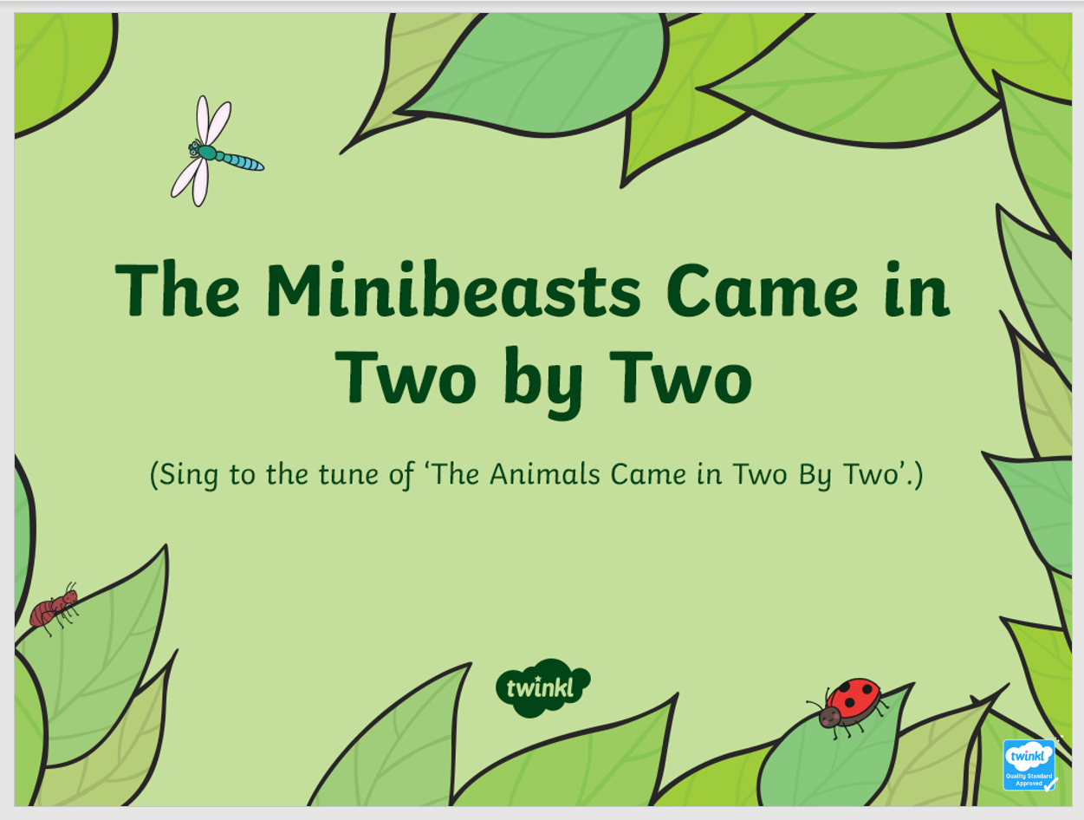
Activity 1 – The minibeasts came in two by two
This weeks song has a PowerPoint to follow. Please see attached.

Slide 3
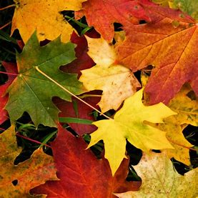
Activity 2 – Leaf sorting
Go out for a walk and collect a range of different leaves. Can you sort the leaves in different ways? Can you sort them by colour? Can you sort them by size? Can you select three of them and put them in size order?

Slide 4
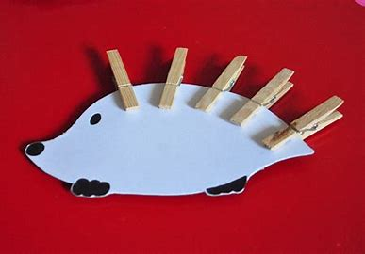
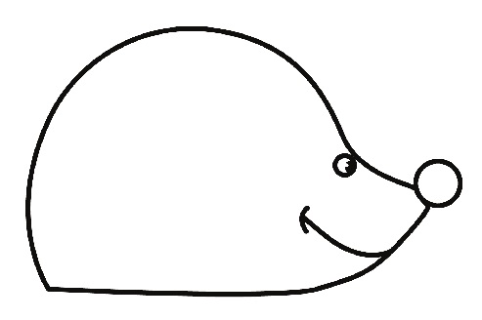
Activity 3 – Number hedgehog
Start by printing off or drawing your own template of a hedgehog. Then find some pegs to be the prickles. Give your child a number and see if they can put the correct number of prickles on their hedgehog. If they do this easily write the numbers on pegs and see if they can put them onto the hedgehog in the right order.

Slide 5
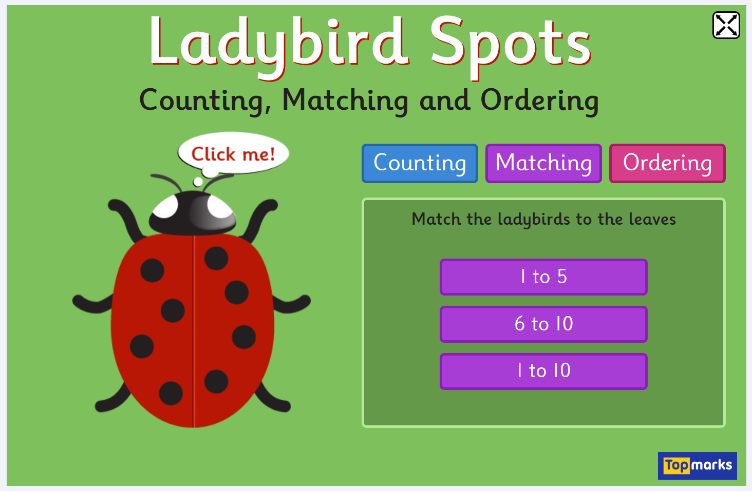
Activity 4 – Ladybirds Spots
Go to www.topmarks.co.uk and have a go at Ladybirds Spots. Do any of the different activities.

Slide 6
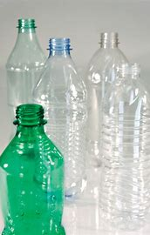
Activity 5 – Water play
You could do this activity in a water tray, a bowl of water, at the beach or in the bath. Have a variety of different containers that can be filled with water. Then get your child to explore filling them and emptying them. Encourage your child to use the vocabulary full, half full and empty. If your child already knows this then they could use a cup to fill the containers. How many cups does it take to fill the container.

