Slide 2
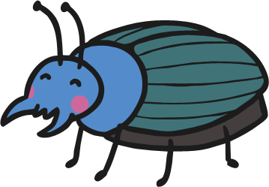
The minibeasts came in two by two,
Errr, ahhh, errr, ahhh.
The minibeasts came in two by two,
Errr, ahhh, errr, ahhh.
The minibeasts came in two by two,
The slugs slithered and the beetle flew,
And they all crawled under the leaves, for to get out of the rain.

Slide 3
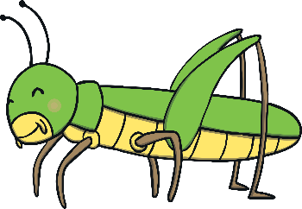
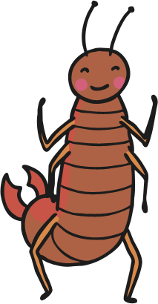
The minibeasts came in three by three,
Errr, ahhh, errr, ahhh.
The minibeasts came in three by three,
Errr, ahhh, errr, ahhh.
The minibeasts came in three by three,
A grasshopper, earwig and a flea,
And they all crawled under the leaves, for to get out of the rain.

Slide 4
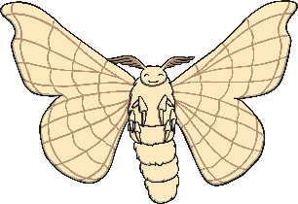
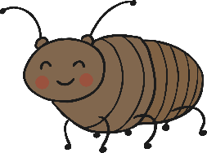
The minibeasts came in four by four,
Errr, ahhh, errr, ahhh.
The minibeasts came in four by four,
Errr, ahhh, errr, ahhh.
The minibeasts came in four by four,
A moth in the air and a roach on the floor,
And they all crawled under the leaves, for to get out of the rain.

Slide 5
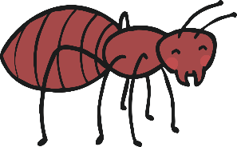
The minibeasts came in five by five,
Errr, ahhh, errr, ahhh.
The minibeasts came in five by five,
Errr, ahhh, errr, ahhh.
The minibeasts came in five by five,
An ant from the hill and a bee from the hive,
And they all crawled under the leaves, for to get out of the rain.

